Slide 1
CSCI 1101 – Group Project
Scott MacDonald | James MacPhee | Craig Spence | Matt Peachey

Slide 2
Topic: Card Game
Our group set out to implement the card game Euchre
We utilized the core concepts of object oriented programming, as well as ArrayLists and other fundamental Java concepts
The JavaFX libraries enabled us to implement a very functional GUI for our project

Slide 3
Separation of work
Scott
Programmed the Card and Deck classes
Assisted in debugging the Table class.
Wrote the majority of our report
James
Programmed the Team and Player classes
Programmed the Table class
Assisted with programming in EuchreDemo
12+ hours of tedious debugging
Matt
Created all of the JavaFX GUI
Programmed EuchreDemo to ensure
GUI compatibility with other classes
12+ hours of tedious debugging
Created PPT
Craig
Designed the UML Diagram for our project.
Assisted programing the table and team classes
Managed Team Productivity (set deadlines etc)
Contributed crucial insight to the ins and outs of
Euchre, and helped ensure that the game ran

Slide 4
Functionality: Cards & Deck
Our program has a Deck of Cards, which is an ArrayList filled with Card Type objects
We specifically chose to use an ArrayList so that we could utilize the Collections.shuffle() to shuffle our deck of cards as required by the game
Each Card was given a ranking which was later multiplied based on each iteration of the “Trump Card” to ensure proper functionality of our game

Slide 5
Functionality: Table
The Table class is where the majority of the game processing takes place
The Table class deals each player a hand from the shuffled deck
The table class sets the Trump card to be the first card that is left over after the hands are dealt to each player.
The table class assigns ranks each hand based on the trump for that hand. It multiplies in such a way that the Jacks of the trump Suit color are the highest cards, followed by the remaining cards in the trump suit, while finally leaving the ranks of the remaining cards untouched
The table class also determined which cards the computer should play for the opponets of the game. This was done in such a way that the computer would always follow suit as expected

Slide 6
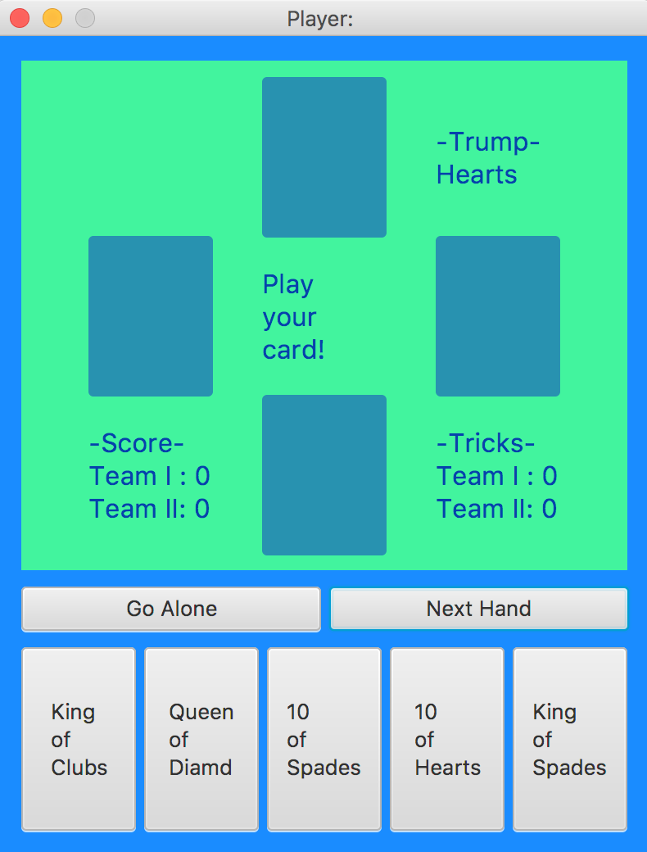
Functionality: GUI
Our Program relied heavily on a user interface
JavaFX was used to create two minimalist yet very functional windows that contained everything needed to play this card game
Each button was mapped to a specific method in the EuchreDemo class that allowed it to perform the desired task
All of important game info (Trump, Tricks, Score, etc) was displayed on our GUI

Slide 7
Questions?
At this time we would love to answer any questions

Slide 8
Thank You
Thank you Dr. Reilly and Dr. MacKay for teaching a great class.

